Slide 1





Association between parents’ empathic accuracy
in dyadic and triadic interactions
and family shared time
Anthony Mauroy*, Justine Gaugue, Sarah Galdiolo
*Postdoctoral Researcher, Senior Teaching Assistant at the University of Mons, Belgium
anthony.mauroy@umons.ac.be

Slide 2






Thoughts
Empathic Accuracy (EA)
Feelings
Relationship
Reduction of family time
How do parents understand each other when interacting with their child ?
Context
Presence of the child
Does the presence of the child matter ?
Does family time (time usually spent together) matter ?
Bornstein et al. (2020) ; Claxton & Perry-Jenkins (2008) ; Halford et al. (2018) ; Hinnekens et al. (2020) ; Ickes (1990)
2

Slide 3
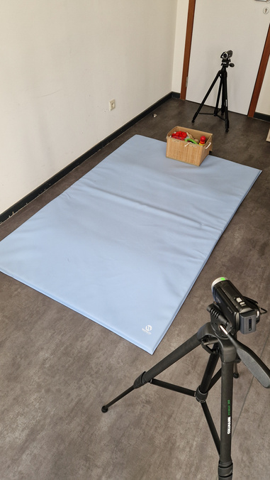
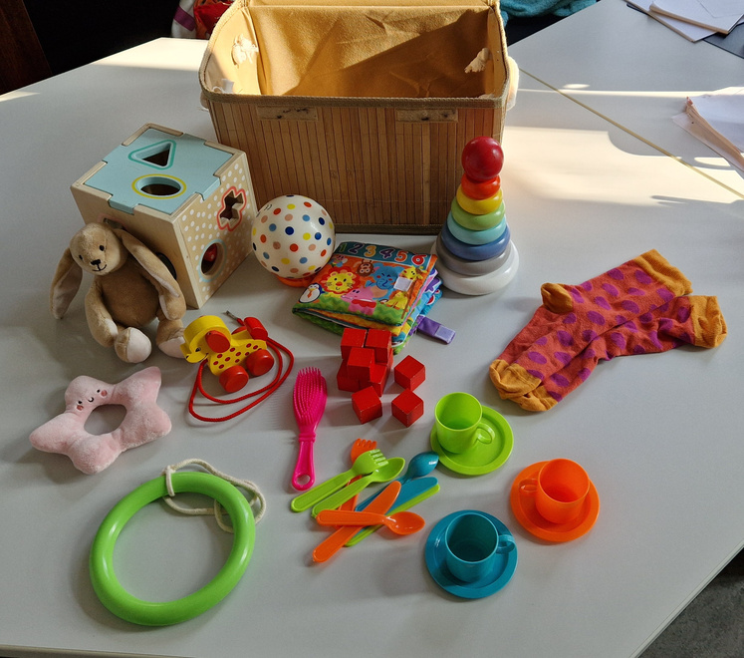
Sample
Procedure
Free play +
Dyadic Interaction Paradigm
40 Parents-child triads
34.03 years (5.97)
1
Dyadic interaction
57.5% of boys
32.9 years (4.84)
2
Triadic interaction
10.31 years of relationship (4.61)
47.5% married
3
  Thoughts and feelings - recall task for EA
  Questionnaire about Family time :
    Couple time
    Child time
    Triad time
Ickes (1983) ; Loop et al. (2017) ; Milek et al. (2017)
3

Slide 4
Linear Mixed-effects model
APIM analyses
No difference in dyad vs triad
(B = -0.2; SE = .80 ; p = .799)
Couple time
EAD
B = 2.07
EAT
B = 2.39
Except for thoughts : easier to understand in dyad
(B = -2.48 ; SE = .99 ; p = .014)
Couple time
EAD
M (SD) = 24.42 (10.83)
M (SD) = 24.98 (9.55)
EAT
EAD
EAT
Child time
EAD
EAT
B = 2.84
Child time
EAD
Thoughts
EAT
M (SD) = 28.29 (15.30)
Does the presence of the child matter ?
Does family time (time usually spent together) matter ?
Not really, except for toughts
Father’s investment is beneficial for understanding
Cerrato & Cifre (2018); Hall & Schmid Mast (2007); Jospe et al. (2020); Nomaguchi et al. (2005); Parker (2013); Schulz (2021); Zaki et al. (2009)
4

Slide 5

Association between parents’ empathic accuracy
in dyadic and triadic interactions
and family shared time
Anthony Mauroy*, Justine Gaugue, Sarah Galdiolo
Preprint

